Slide 1

Emerging Technologies
Session #07: Previously on…
IBM Bluemix
The Digital Innovation Platform
Sylvain-Roch WILBERT
s_wilbert@fr.ibm.com
Université Paris - Dauphine

Slide 2

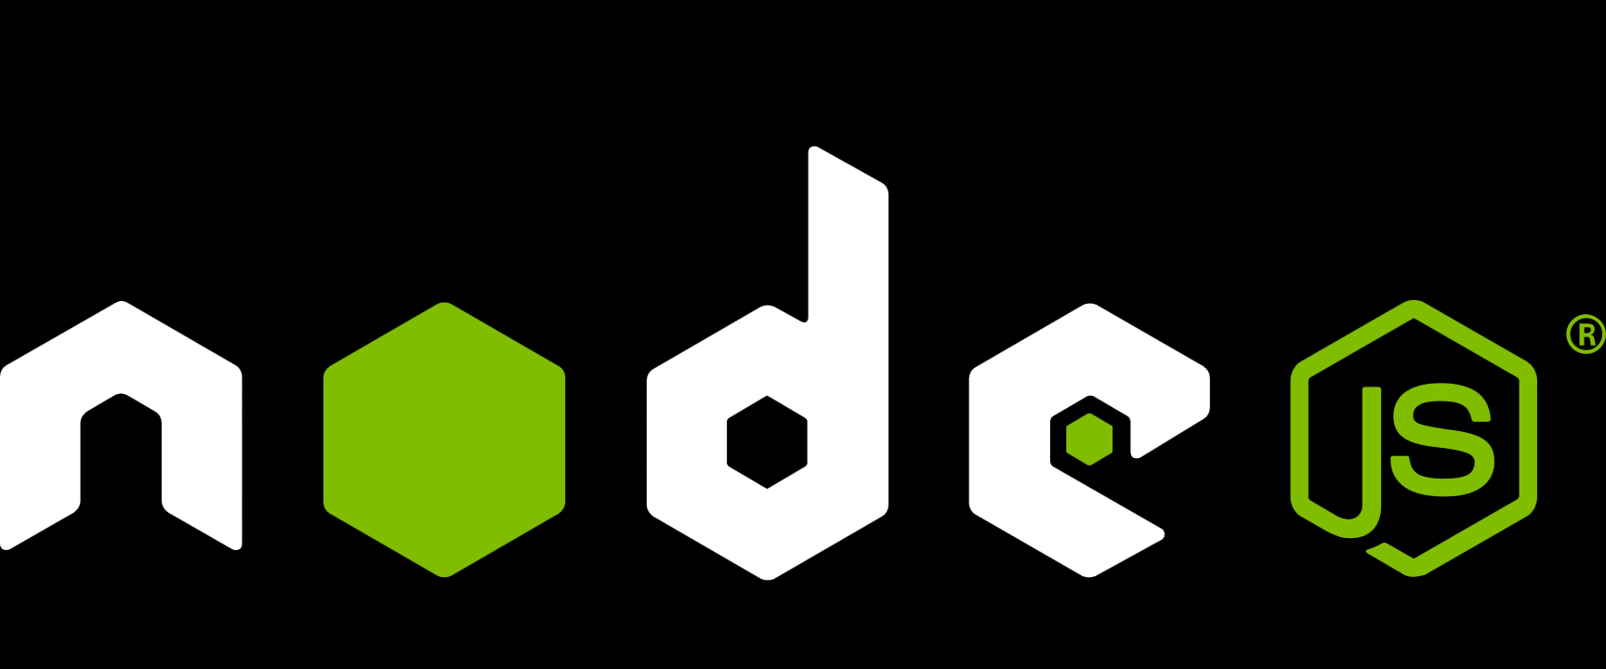






Emerging technologies Our 2-days- Journey
IBM Bluemix
A « Hands-on » experience to deploy in 2days, a live nodejs web application on internet with
A noSQL Datarepository
Cognitive capabilities (Real time translation, language detection, Personality profiling)
APIs to be integrated with the external world
Implemented in a seamless Build and Deploy approach
Hosted In the cloud !! (2-clicks provisionning, Scalability…)

Slide 3

Emerging technologies An introduction – The App Revolution !
Apps are everywhere
The quantity and usefulness of web and mobile apps has led to an “app revolution” among consumers and businesses alike.
Experience matters
Customers and employees now expect a delightful and seamless experience across all interactions with a business.
Cloud makes it possible
Apps today can be stitched together quickly with pre-built assets. Cloud makes the API economy possible.

Slide 4
SoR, SoE, SoI, Different concerns, different approaches
Support Processes
Tradition Entreprise Systems acting as referentials for data and processes
ERP
Directories
…
Remark : Sometimes called System of Reference
System of Record
System of Insight
System of Engagement
Support to Decision Making
integrates data in the SoE, SoR
FindS new relationships and patterns byÒ
- analyzing historical data,
- assessing current situation,
- applying business rules,
- predicting outcomes
- proposing the next best action.
Touches People
deliver apps and products directly in the context of the daily lives
- mobile,
- social,
- cloud …..

Slide 5

Timing is critical Today’s apps must keep up with the speed of the app revolution.
Platform as a Service
Customer Managed
Service Provider Managed
Code
Benefits
Setup environments and deploy apps very quickly.
Infrastructure and platform managed by Service Provider.
Data
Runtime
Middleware
Time Commitment
Minutes to setup and deploy.
Focus on your apps and their data.
OS
Virtualization
Servers
Storage
Networking
IBM Bluemix
Core IT
IaaS
Time to initial deployment
~ Weeks
~ Days
~ Minutes
Notes:
We’ve realized that, in a large number of use cases, our customers want to move even faster and don’t need to spend the time managing the platform (VM, OS, Middleware, Runtime). IBM’s answer: Bluemix (platform as a service).
PaaS Benefits
Setup your environment and deploy apps quicker than any other offering
Service provider manages the Infrastructure AND the platform
PaaS Time Commitment
Minutes to initial deployment - developer can handle everything on his/her own
Maintenance and upgrades of Platform and Infrastructure handled by service provider

Slide 6














Leverage the power of Bluemix without abandoning what you already use.
Core IT
IaaS
PaaS
IBM Bluemix
Notes:
While timing is critical (what we just discussed), the systems and data you use today can’t be forgotten. That’s why Bluemix simply and securely connects to core IT and even other clouds (leveraging IBM’s proven reputation as a systems integrator).
Hybrid cloud, where Public and Private clouds work together with Core IT investments, is critical to success given the app revolution and the expectations and increased competition it has generated.
Overall, hybrid cloud represents the “New IT…”

Slide 7
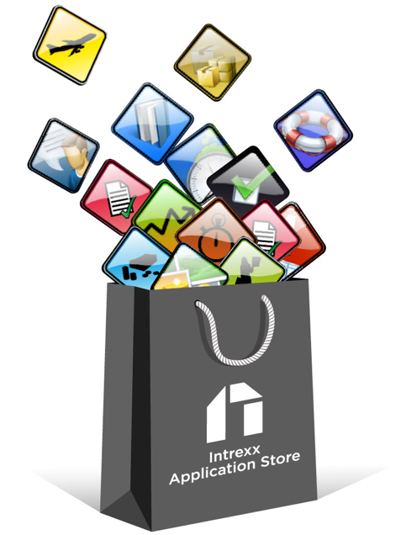
Bluemix, an opportunity for SaaS
SaaS
PaaS
IBM Bluemix
Notes:
Bluemix est pour vous un accélérateur d’opportunités

Slide 8
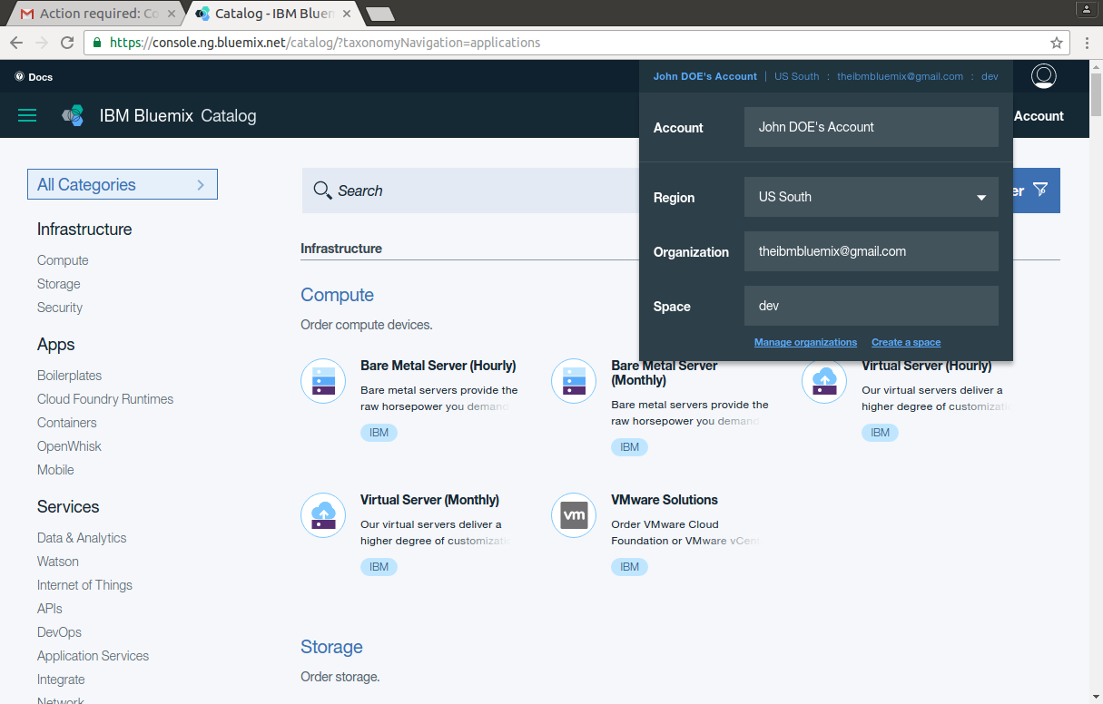
Navigating around the world
1
Navigate across
Regions
Organization
Space

Slide 9
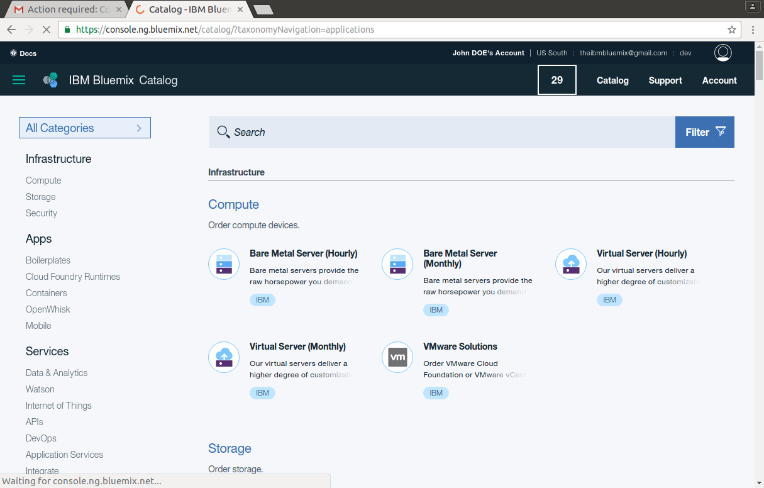

Parsing the catalog
1
Access the service Catalog clicking on
You can browse all the services organized in categories

Slide 10
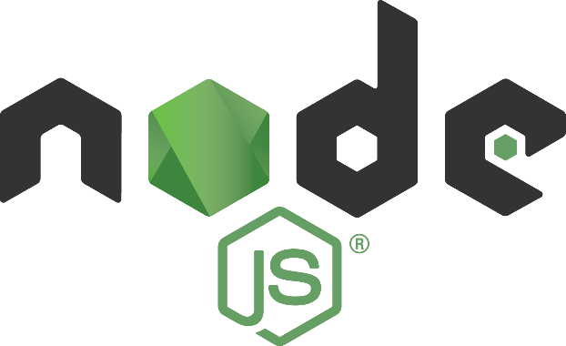
Node.JS Javascript on server side
Node.JS : An opensource platform, event driven to create web application relying on Javascript run on server side.
Main differentiators of Javascript language on server side
Asynchronous with non blocking inputs/outputs
Base on the Javascript 8 Gogglen engine.
Some characteristics of Node.JS
Event-driven implementing callbacks
Node.JS relies on a single processing Thread (default)
API simple et modèle modulaire
npm Package manager to manage the system
…so many libraries already available.

Slide 11
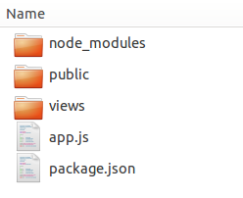
NodeJS in a nutshell
Libraries
Your static files ( logo, stylesheet)
Your templates
Your application (the code…)
Your application description

Slide 12
NodeJS in a nutshell
Node
Launching an application
node app_name.js
or
npm start if package.json contains the directive
Add the required libraries from a terminal by using the
npm install LIBRARYNAME --save
node_module directory will be created, and libraries downloaded
Packages.json will be updated

Slide 13
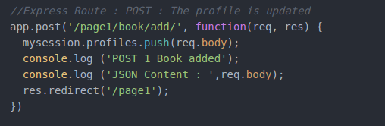
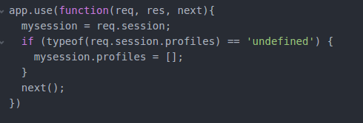
NodeJS in a nutshell
Express
routing and middleware web framework
Routing : Allows to definition of application end points (URIs) and how they respond to client requests
Middleware are functions that have access to the request and response
Execute any code.
Make changes to the request and the response objects.
End the request-response cycle.
Call the next middleware function in the stack.

Slide 14
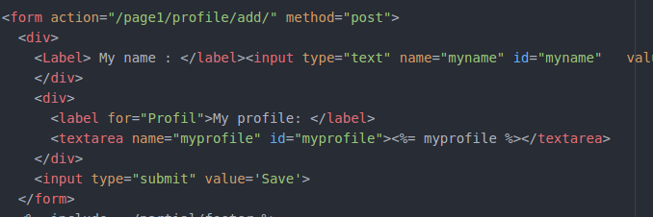
NodeJS in a nutshell
Templates
allow you to split presentation information out from program code

Slide 15

CloudFoundry in a nutshell
Cloud Foundry is
an open source cloud computing platform as a service (PaaS). It is an industry standard platform for cloud applications
It enables a tool to deploy applications in the cloud : cf Command Line Interface
cf api https://api.ng.bluemix.net (US South Region)
or cf api https://api.eu-gb.bluemix.net (UK Region)
cf login -u YOUR_EMAIL -o YOUR_ORG -s YOUR_WORKSPACE
cf push YOUR_APPNAME -m 512m

